Slide 1
Answering the assessors’ prayer …
“Oh, Lord, send me a good one!”

Slide 2
It’s an exam and a story …
Like all exams, the keywords and answers are contained in the questions.
A lot of technique for individual Qs - but also requires a compelling narrative.
Essentially 10 scored questions (+ 3 appendices) requiring answers of no more than 400 words each, giving you 4400 words to convince them …
UCL 26 March 2019

Slide 3
… when you include the
Project Summary
Please provide a short summary of your project. We will not score this summary. (400 words)
This is the first thing they read. They need to read it and say ‘wow!, I get this and I like this’.
Top tip – ‘Economist’ editorial style. 9 word sentences, active tense.
UCL 26 March 2019

Slide 4
1. Need or challenge
What is the business need, citizen challenge, technological challenge or market opportunity behind your innovation? (400 words)
“Here’s an unmet business needs that is costing or denying (John/s) value. We can develop the tech/service/product to fix this challenge and when we do, (John/s) will buy it.”
“Here’s some stuff that shows we understand the wider context, too”
UCL 26 March 2019

Slide 5
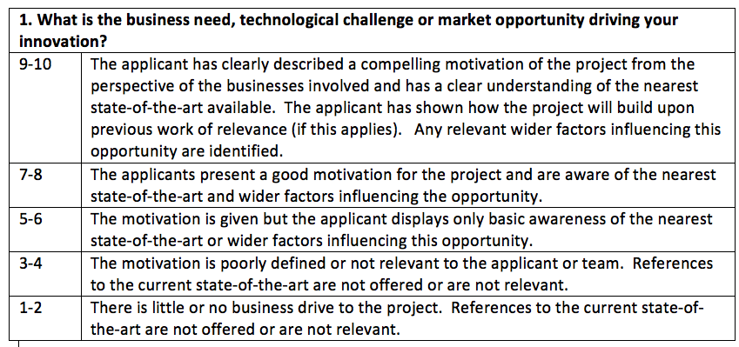
1. Need or challenge
UCL 26 March 2019

Slide 6
2. Approach and innovation
What approach will you take and where will the focus of the innovation be? (400 words)
“We will technically solve the challenge by x,y,z. This is better than competitors a, b, c because … Based on earlier work (patent searches) we have freedom to operate. We will deliver (this/these) outputs.”
“and here’s a picture (Appendix Q2) that oozes ‘wow factor!’”
UCL 26 March 2019

Slide 7
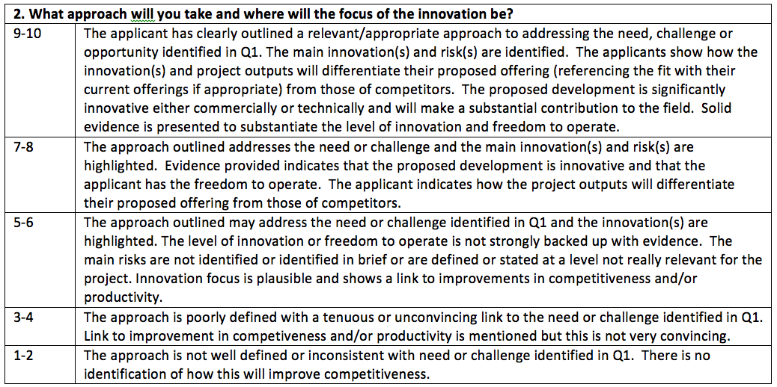
2. Approach and innovation
UCL 26 March 2019

Slide 8
3. Team and resources
Who is in the project team and what are their roles? (400 words)
“Our team is the best - and here’s a list of credentials/track record that shows we can build it and get traction in the market. We will additionally need (these) resources and this is where we get them”.
Do not be shy!
UCL 26 March 2019

Slide 9
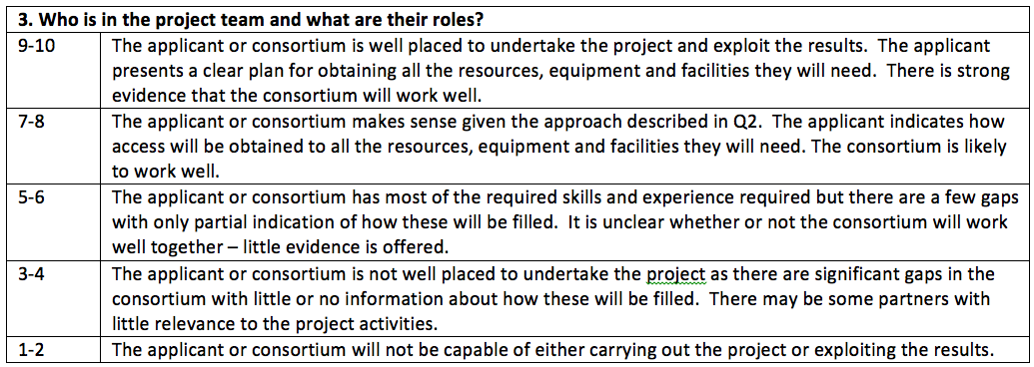
3. Team and resources
UCL 26 March 2019

Slide 10
4. Market awareness
What does the market you are targeting look like? (400 words)
The market looks like (this) and here’s the trends with numbers and recent references that show we really know our stuff. Our target addressable market is (sensible, conservative, argued) numbers).
UCL 26 March 2019

Slide 11
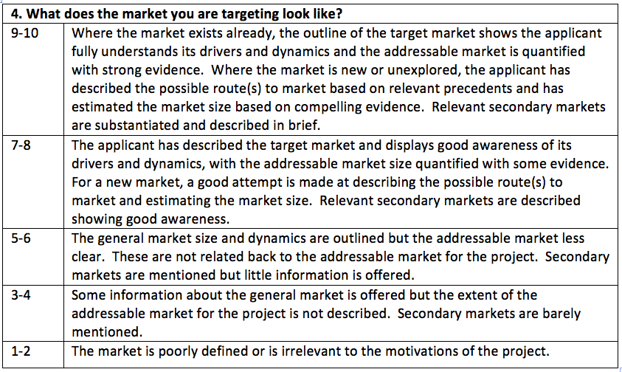
4. Market awareness
UCL 26 March 2019

Slide 12
5. Outcomes and route to market
How are you going to grow your business and increase your productivity into the long term as a result of the project? (400 words)
“The value proposition to our target customers is (how they benefit in a business sense and it’s worth x to them). Our routes to market are (credible ideas, preferably relevant to market identified in Q4). Currently we sit (here) in the market but this project will take us to (there).”
UCL 26 March 2019

Slide 13
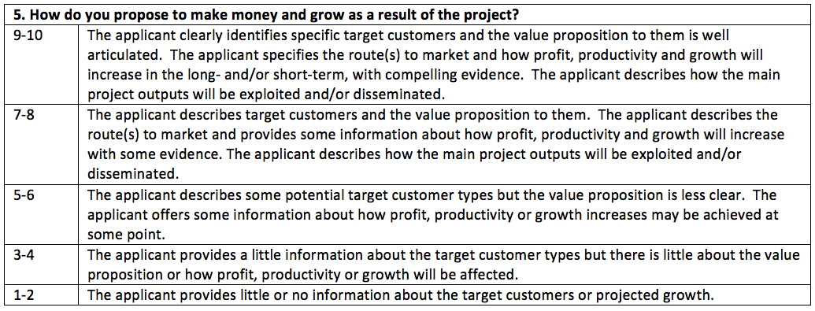
5. Outcomes and route to market
UCL 26 March 2019

Slide 14
6. Wider impacts
What impact might this project have outside the project team? (400 words)
“There are external (wider) benefits to (economic/social/environmental/greater good stuff) attributable to this solution being implemented and they are worth (some sort of guestimate). Stress any regional impacts (local economy stuff).”
UCL 26 March 2019

Slide 15
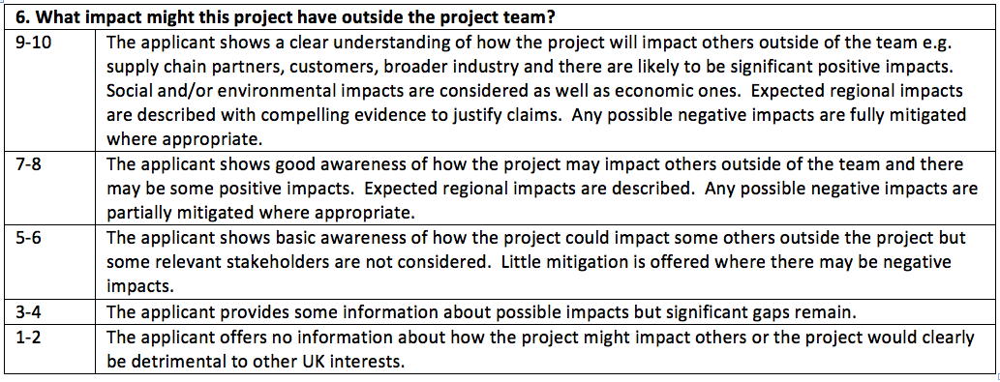
6. Wider impacts
UCL 26 March 2019

Slide 16
7. Project management
How will you manage the project effectively? (400 words)
“Here’s a tickety-boo project plan (work packages, costed, research category, description of deliverables, management techniques and structure”
“and here’s a funky Gantt chart (AppendixQ7)”.
UCL 26 March 2019

Slide 17
7. Project management
UCL 26 March 2019

Slide 18
8. Risks
What are the main risks for this project? (400 words)
“Here’s a thorough risk assessment (project/technical/commercial/environmental/regulatory/whatever) with risk ownership assigned and sensible mitigation suggested along with a description of how risk will be managed during the project.”
“and here’s a nice initial risk register (AppendixQ8).”
Top tip – this is a ‘graph question’, label the axes.
UCL 26 March 2019

Slide 19
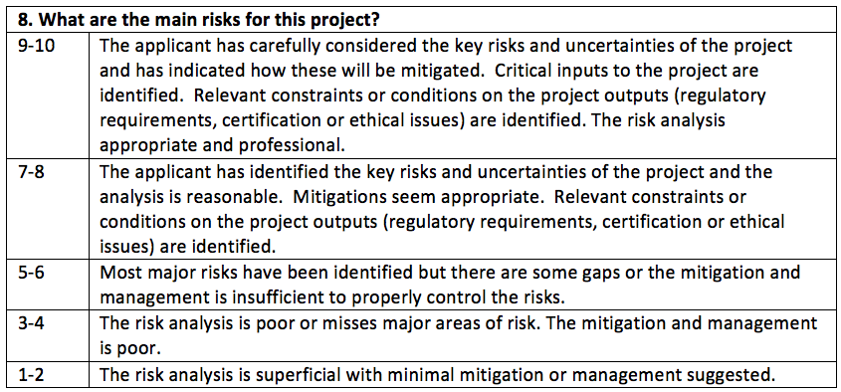
8. Risks
UCL 26 March 2019

Slide 20
9. Additionality
Describe the impact that an injection of public funding would have on this project. (400 words)
“We seriously need support. It will not happen without it. Support enables (faster time to market; derisking to the point where private investors will come in; a new type of collaboration) – and look at those awesome (stakeholder and/or wider) benefits.”
UCL 26 March 2019

Slide 21
9. Additionality
UCL 26 March 2019

Slide 22
10. Costs and value for money
How much will the project cost and how does it represent value for money for the team and the taxpayer? (400 words)
“It’s excellent value for money - look how modestly the workpackages are costed. Subcontracts are justified because (they’re the best/we worked well with them previously/etc). The return to the tax payer comes from (increased VAT/payroll taxes/improved productivity/efficiency/contribution to govt strategy/etc).”
UCL 26 March 2019

Slide 23
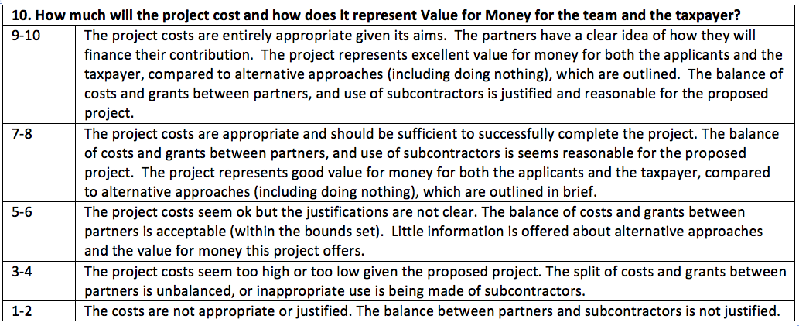
10. Costs and value for money
UCL 26 March 2019

Slide 24
small print …
… will kill you!
(insert funny story)
Scope. If in doubt, check with lead technologists at Innovate UK. Use the competition help. They are helpful.
UCL 26 March 2019

Slide 25
feedback …
… will kill you, too!
Typically 5 assessors assigned:
1 will want to have your babies.
3 will “oi’ll give it five” (more like 7, actually).
1 would rather eat worms than see your project funded.
UCL 26 March 2019

Slide 26
Summary
Wow them from the off.
Answer the questions.
Put effort (and more wow) into the Appendices.
Use short, punchy sentences. Create a narrative flow.
If in doubt, ask. KTN has a view; Innovate UK are the arbitrators.
UCL 26 March 2019

Slide 27
That’s enough.
Thank you!
Questions?
richard.foggie@ktn-uk.org
@foggie_esp
UCL 26 March 2019

